Slide 1

ATM TRANSACTIONS ANALYSIS (A case study Report of Wisabi bank)
By:
Teja Sree Goli

Slide 3
Data Collection and EDA
Problem Statement
Data Preparation (ETL)
Data Modeling and Analysis
Presenting the Findings
Data Validation
Problem Analysis Framework

Slide 4
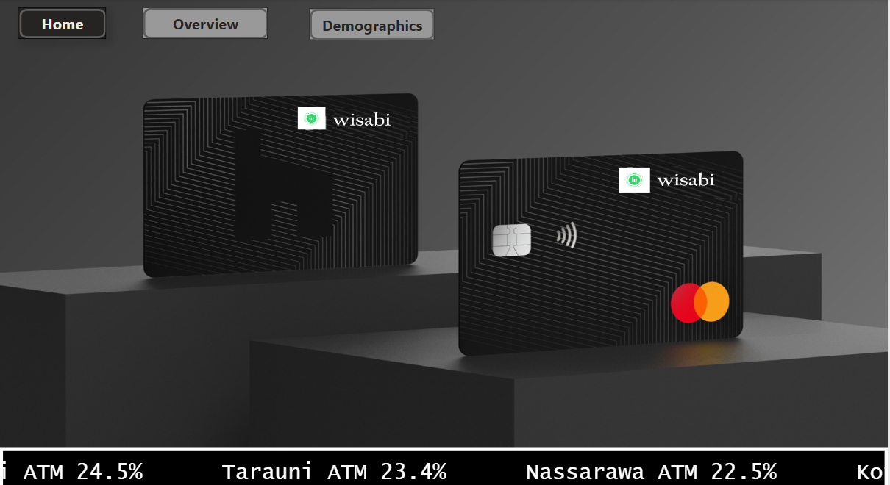
Dashboard Home Page

Slide 5
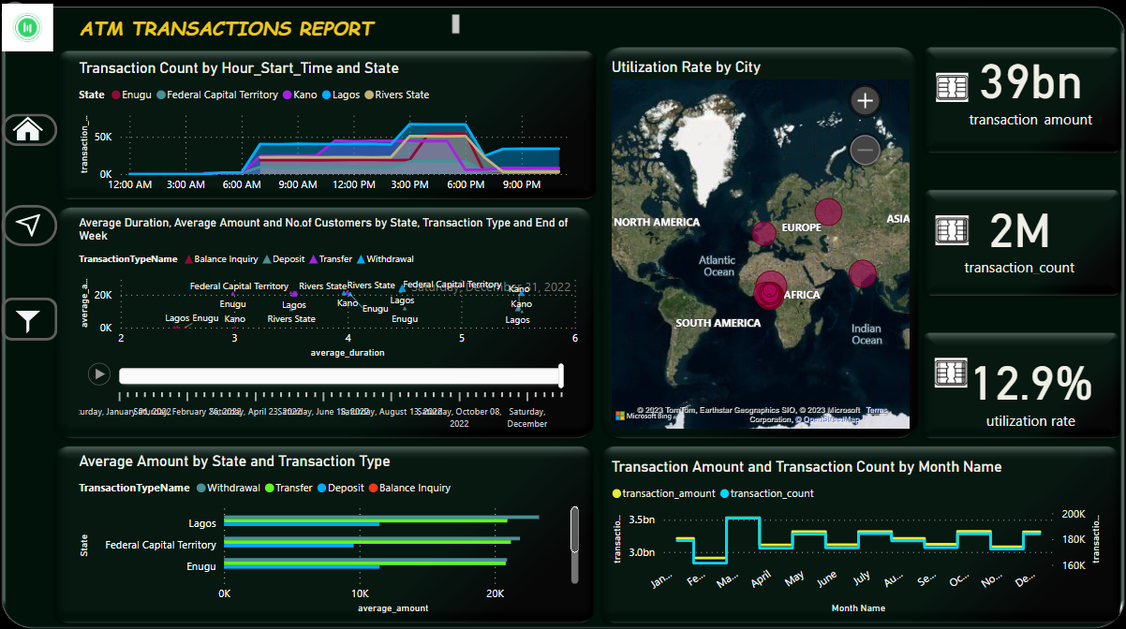
ATM Transactions Report Page

Slide 6
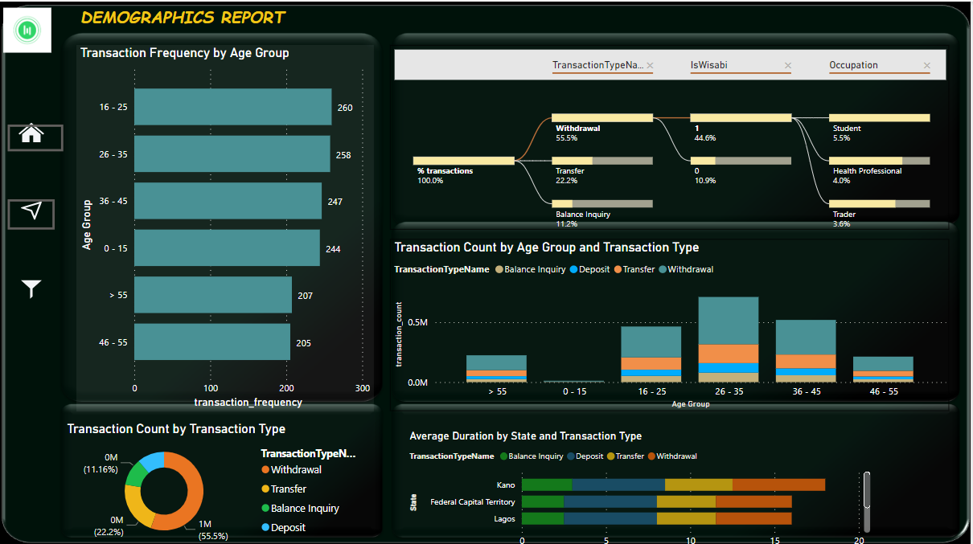
Dashboard Demographics Page

Slide 7
From the Analysis:
Total Amount Processed by Wisabi ATMs in 2022: ~ 39 Billions
Number of Transactions Processed: 2,143,838
Distinct Customers used the ATMs atleast once: 8819
Total Utilization Rate: 12.9%

Slide 8
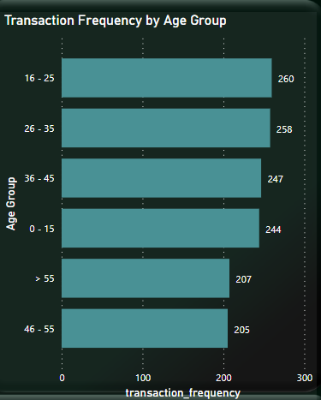
Transaction Frequency
The customers with age group: 16-35 have done the most transactions using the ATM cards.
The frequency of transactions done by age group: 46-55 is comparatively less than those of customers with age group: >55yrs

Slide 9
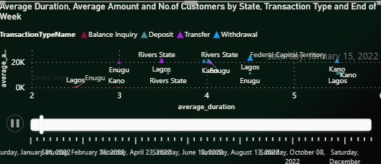
Average Amount vs Average Duration
After analyzing average duration for making a transaction in each state, Kano stood out with average duration of >5min for withdrawals, when compared with the other states.
Withdrawals and Deposits have longer transaction duration on average while Balance Inquiries have the least transaction duration.

Slide 10
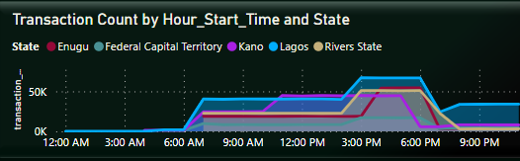
Daily Transactions Trend
ATM Transactions in Lagos increase gradually from 6 am and peaks between 3 and 7 pm.
Similar behavior is seen across other states however transactions peak earlier in Kano (around 11 am) and this is sustained till about 5 pm after which activity sharply declines.

Slide 11
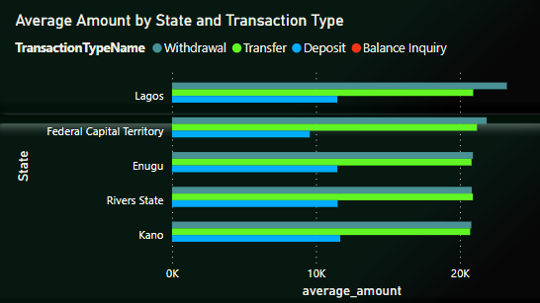
Average Transaction Amount
On Average, Withdrawals have the highest transaction amounts across all states, next is Transfers, with Deposits have the lowest.
Across all locations, The FCT has comparatively lower Deposit amounts on Average

Slide 12
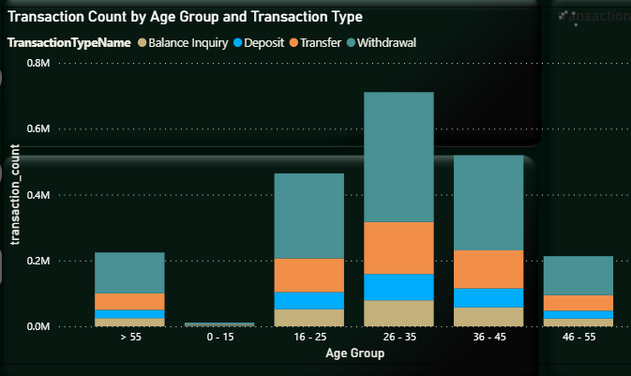
Transaction Count
Across all Age Groups, Withdrawals is the common transaction type (>50%), followed by Transfers (>20%)
Deposits & Transfers account for a significant amount of transactions (>10% each) across all Age Groups

Slide 13
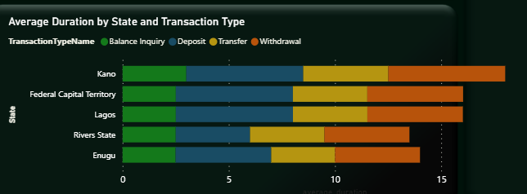
Average Transaction Duration
Kano’s average Withdrawal, Transfer, and Balance Inquiry durations are comparatively higher than other locations.
Rivers & Enugu have lower average transaction duration for Deposits, Transfers, & Withdrawals when compared to other locations.

Slide 14
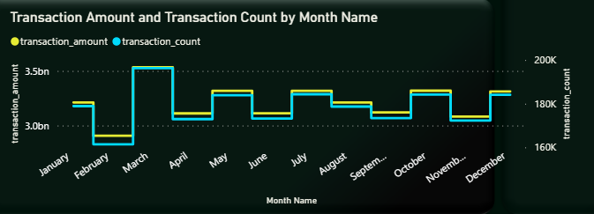
Trend of Average Transaction Amount and Count
We had the highest number of transactions and transaction amount in March and lowest in February.
Other months with high transaction activity include January, May, July, October, and December

Slide 15
Recommendations!
Utilization rate in the FCT is comparatively low. Possible solutions to this include:
Make sure that the ATMs are visible and accessible to customers. This could involve relocating the ATMs to more prominent locations, installing signage, or improving lighting and landscaping around the ATMs.
Consider offering additional services at the ATM, such as the ability to deposit checks or make cash withdrawals in different denominations.
Conduct surveys or use customer analytics to understand the preferences and habits of customers who use the ATM, and tailor the ATM's services and features to better meet their needs.

Slide 16
Recommendations!
Average Transaction Duration in Kano is longer when compared to other locations. Possible solutions include:
Increase the number of ATMs available in the branch, as this can reduce wait times and congestion at each individual ATM.
Consider upgrading the ATMs to newer models with faster transaction times and more advanced features. This can improve the overall experience for customers using the ATM and may encourage them to use it more often.
Analyze transaction data to identify bottlenecks or issues that may be contributing to longer transaction times. This could involve looking at patterns of usage, common user errors, or technical issues that may be slowing down the process.

Slide 17
Recommendations!
A significant proportion of transactions (>20%) are either Balance Enquiries or Transfers. Possible solutions to this include:
Offer personalized support to customers who may be hesitant to use alternative banking channels, such as providing one-on-one assistance or guidance on how to get started with phone banking or online banking. This can help to build trust and confidence in these channels and may help to shift usage away from the ATM.
Ensure that the phone banking process is simple and straightforward for customers to use, with clear instructions and minimal waiting times.
Continue to monitor customer behavior and analyze usage data to identify areas where usage of alternative banking channels can be improved.

Slide 18
THANK YOU ☺

